Slide 1
Lesson 6

Slide 2

Today’s objectives
Student Outcomes
i) Estimate the parameters for a periodic function (A, P, B, and t0) given a dataset or graph [Focus is $A\sin\left(\frac{2πt}{P}\right)+B ]$
ii) Estimate the parameters for a Gaussian function (A, mean, sd) given a dataset or graph
iii) Estimate the parameters for a Sigmoidal function (A, mean, sd) given a dataset or graph
iv) Identify related/corresponding Gaussian and Sigmoidal function

Slide 3

Desmos Activity
Join our DESMOS activity.
Desmos.com
Join Code: h68zkk

Slide 4
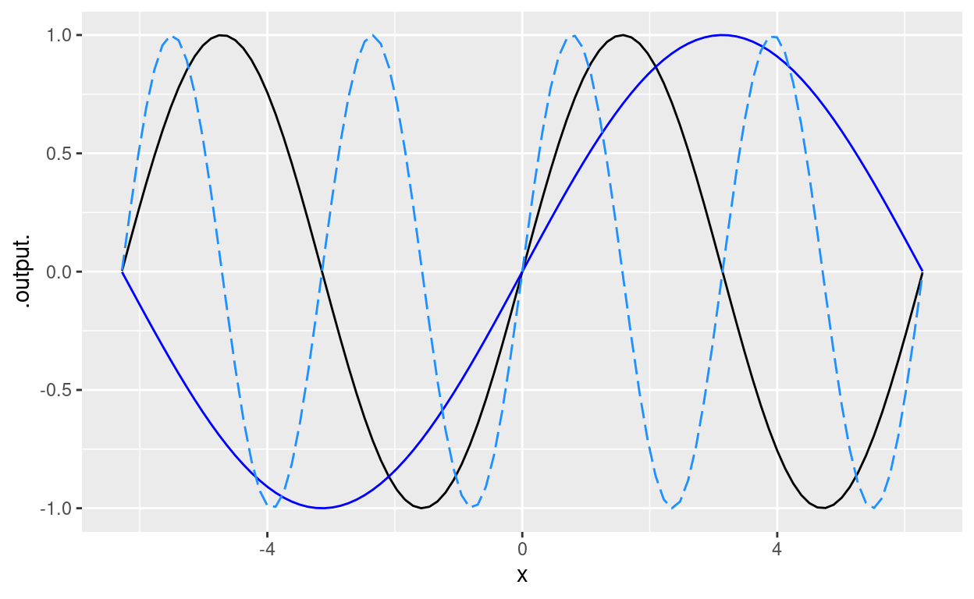

Input and output scaling with the sinusoid
The black curve is the original sine function.
Which curve is $\sin\left(2x\right)$?
Which curve is $\sin\left(\frac{x}{2}\right)$?

Slide 5
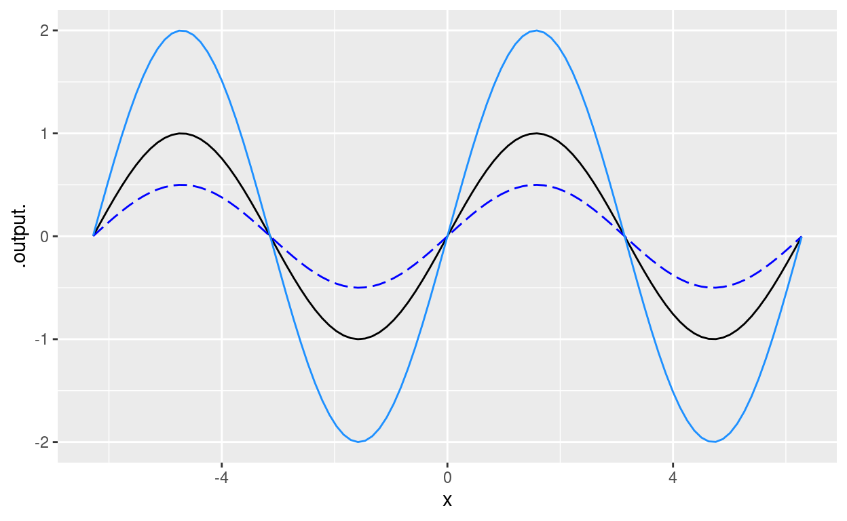

Input and output scaling with the sinusoid
The black curve is the original sine function.
Which curve is $2 sin\left(x\right)$?
Which curve is $\left(\frac{1}{2}\right) sin⁡(x)$?

Slide 6
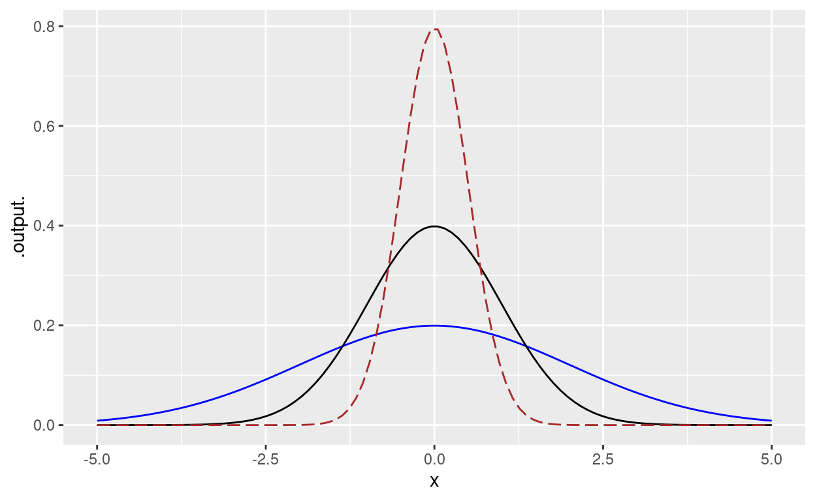
Mean and SD shifts in gaussian
The black curve is the standard Gaussian (mean = 0, sd = 1)
Which curve has the sd = 2?
Which curve has the sd = ½?

Slide 7
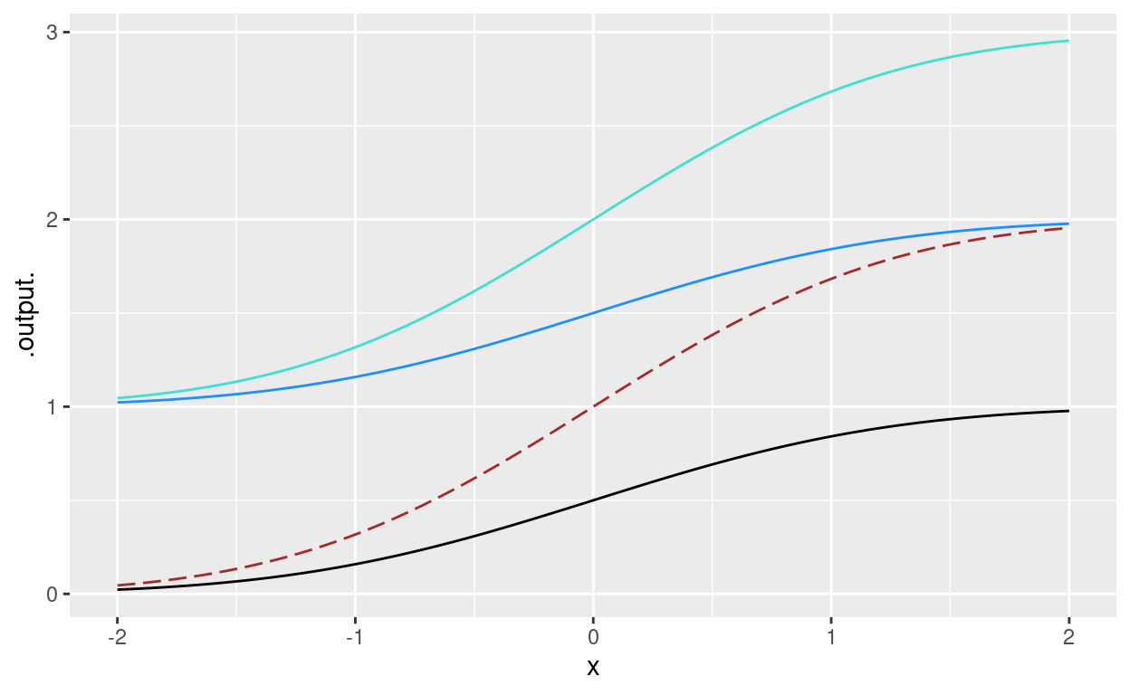
Input and output shifts in sigmoid
The black curve is the basic sigmoid
Which of the curves is graphed by 2*pnorm(x)?
Which is graphed by pnorm(x) + 1
Which is graphed by 2*pnorm(x) + 1?

Slide 8
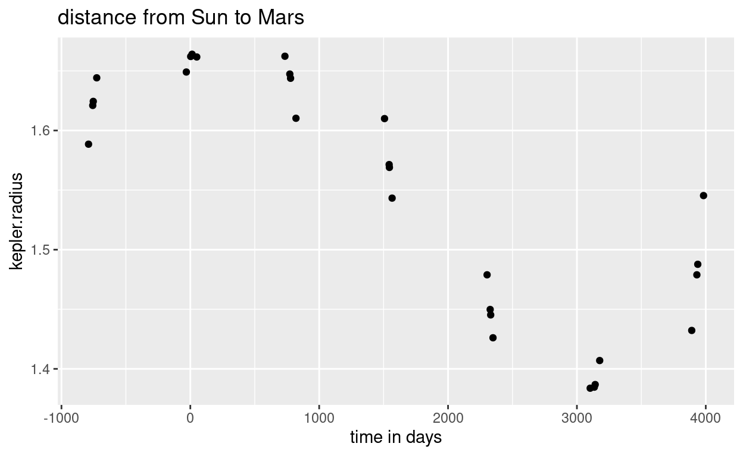
Kepler’s data on Mars
gf_point(kepler.radius ~ time, data=Kepler)

Slide 9
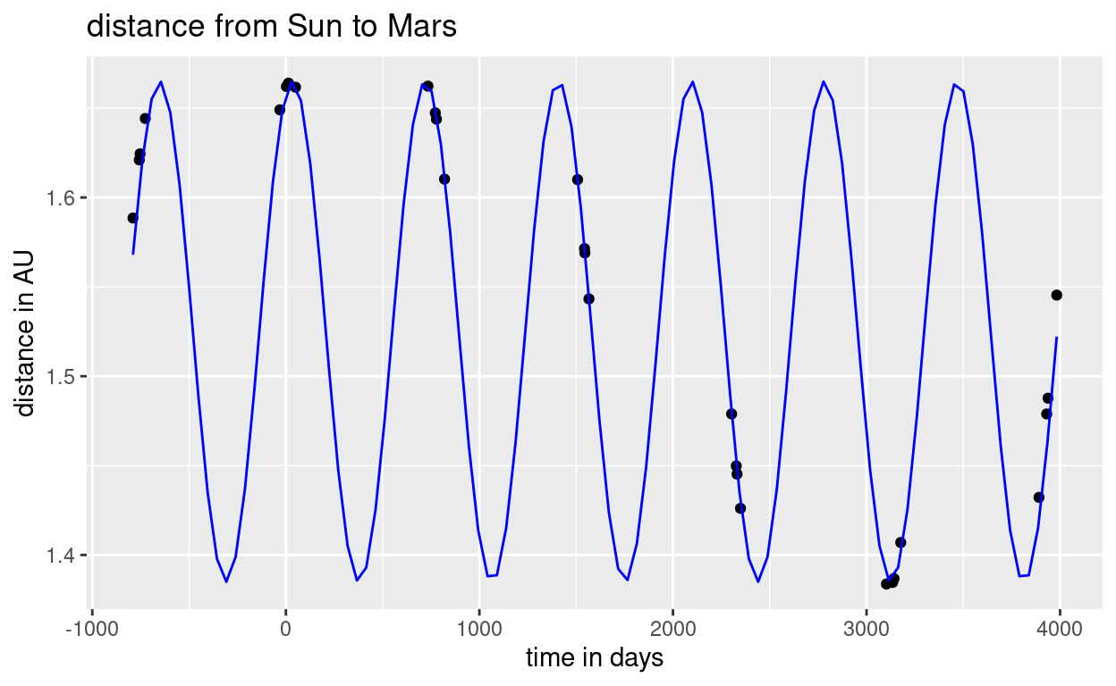

Find a function of the form $radius\left(t\right)≡A sin⁡({2π(t−t_{0})}/{P)}+B$ to fit the curve shown. Hints: First find $A$, $P$, and $B$ Then worry about the $t_{0}$
Notes:
gf_point(kepler.radius ~ time, data = Kepler) %>%
gf_labs(title = "distance from Sun to Mars", x = "time in days", y = "distance in AU") %>%
slice_plot(.14*sin(2*pi*(time-550)/687) + 1.525 ~ time, color="blue")

Slide 10
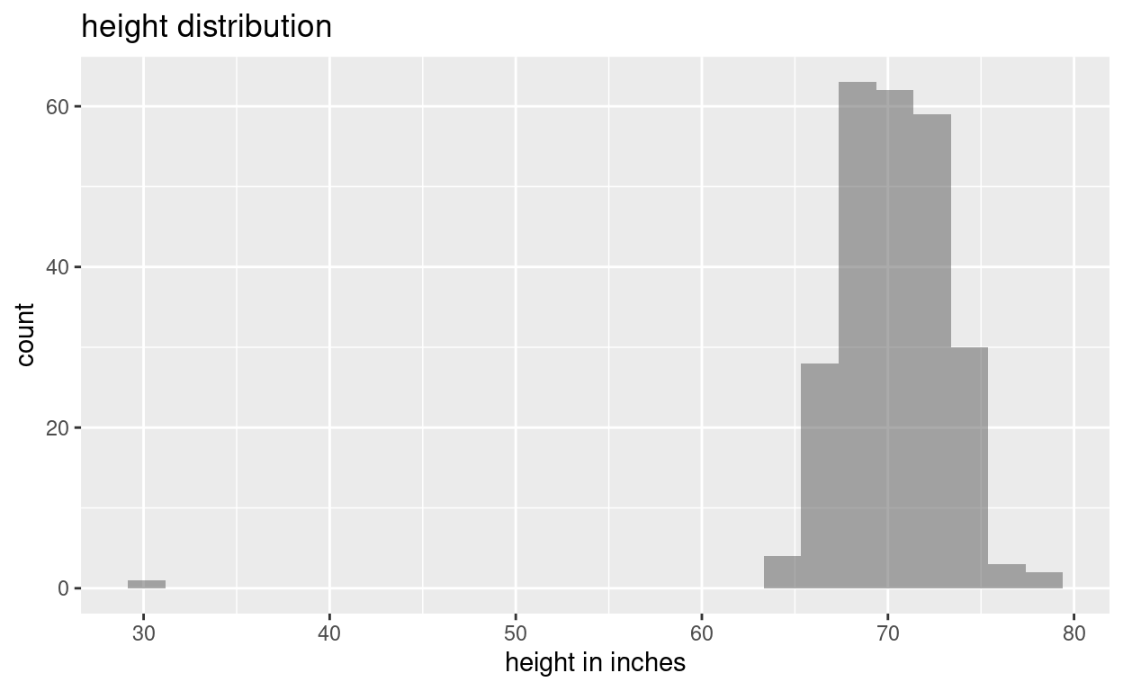
Fit a Gaussian to data
gf_histogram( ~ height, data = Body_fat)%>%
gf_labs(title = "height distribution", x = "height in inches")

Slide 11
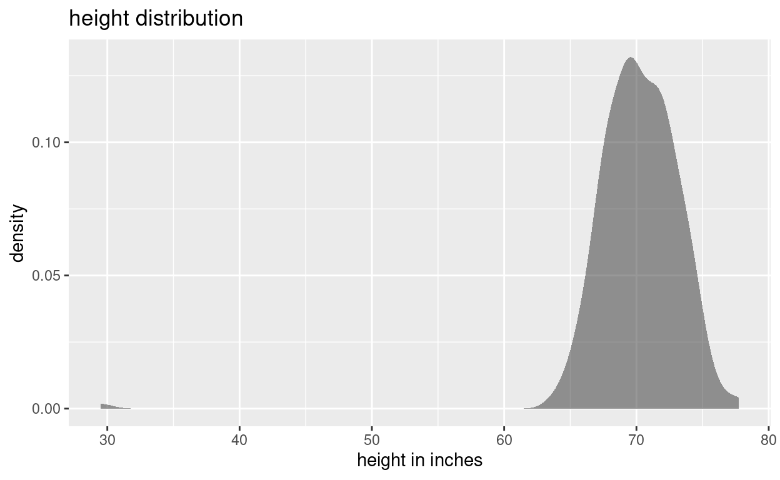
Fit a Gaussian to data (smoothed)
gf_density( ~ height, data = Body_fat) %>%
gf_labs(title = "height distribution", x = "height in inches")

Slide 12
Check your graph against your guess
gf_density( ~ height, data = Body_fat) %>%
gf_labs(title = "height distribution", x = "height in inches")%>%
slice_plot(dnorm(height, mean = ___, sd= ___)~height)

